Slide 1
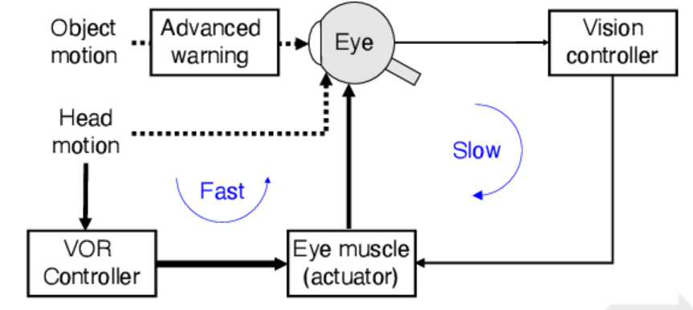
Robust and efficient control using temporally layered architecture
We present a temporally adaptive Reinforcement learning architecture.
The architecture is temporally layered, inspired from biological control systems.
This allows the system to be:
efficient: allowing control with fewer selected actions.
Robust: allowing it to handle perturbations in the environment that cannot be handled by the slower network
Life-long learner: Additional layers can be added for changes in the environments or agent. Without having to retrain the agent entirely.
Picture taken from:
Nakahira, Yorie et al. “Diversity-enabled sweet spots in layered architectures and speed–accuracy trade-offs in sensorimotor control.” Proceedings of the National Academy of Sciences 118 (2021): n. pag.

Slide 2
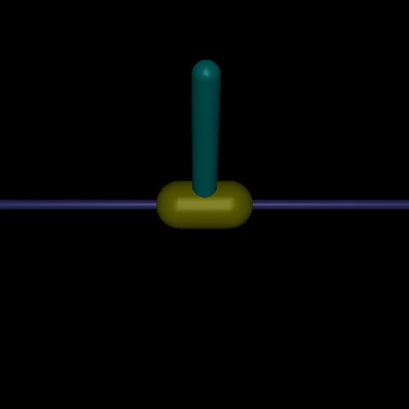
Biologically inspired architecture
Slow controller
Fast Controller
Slow
Fast
Action
PLANNED SLOW ACTION

Slide 3
Training and Inference
Train slow network in the normal environment
Add a faster network layer and train it either in the normal environment or a modified environment with added perturbations.
For the faster network: The possible maximum action values = 2 x max_values
The action performed in the environment = min(slow action + fast action, max_value)
After training: Gate the faster network so that it only activates above a certain threshold.

Slide 4
Results
Environment | TLA (Temporally layered architecture, ours) |  | TD3
 | Performance | Actions picked | Performance | Actions picked
InvertedPendulum-v2 | 1000 | 1000 | 1000 | 1000
InvertedPendulum-v2 + perturbations | 107 | 3,692 (70%) | 101.9 | 5095
Hopper-v2
Hopper-v2 + perturbations | 636.2 | 90% | 303.25 | 100%

Slide 5
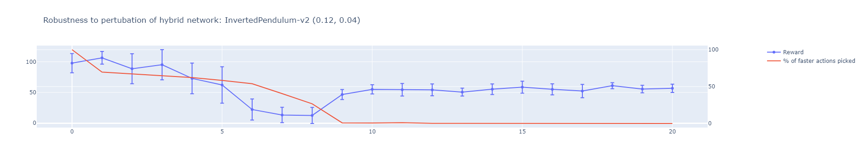
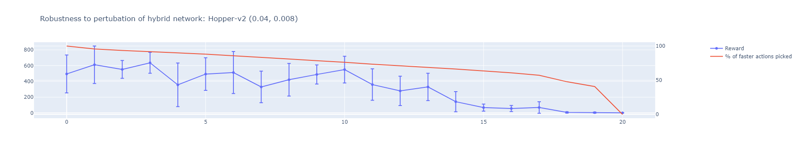

Slide 6
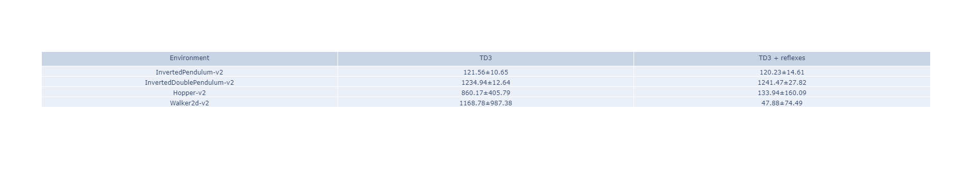
Previous attempt

Slide 7
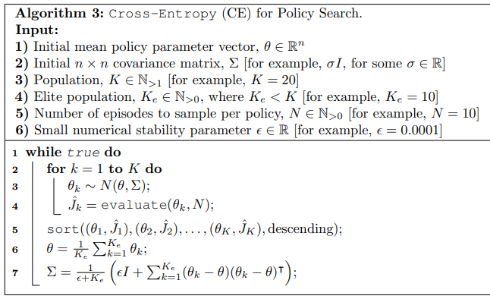
Reflex search using Cross-entropy
The reflex is parametrized as:
For each action dimension:
Θ₁: A threshold value for each input dimension
Θ₂: A scaling value that controls the intensity of the reflex action
Note that two neurons are required for a low and high threshold. However, the parameters can be reduced if the reflex is symmetric
Θ₁
Θ₂
Reflex parametrization

Slide 8
Hand designed reflexes present before training
Agent trained on top of the reflex
Run only for 400000 steps as opposed to million steps on benchmarks
The reflex response time is half of the normal response time

Slide 9
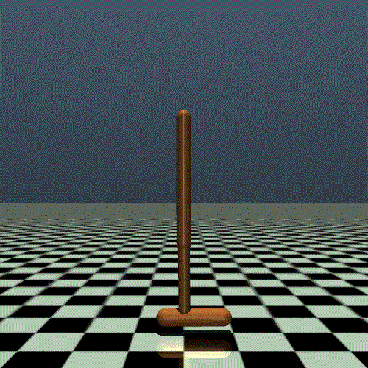
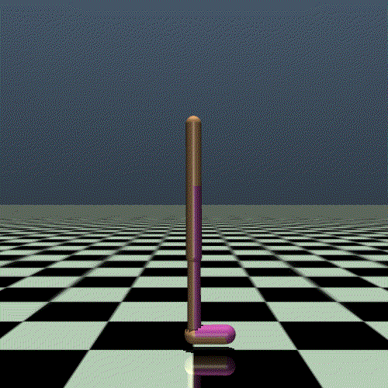
How to design reflexes for this?

Slide 10
Algorithm 1:
Train base network first
Train the fast (reflex) network:
Reward:
(-abs(TD) + reward) if next state for reflex is the next state for the base network
0 otherwise
s₁
s₂
Base network step
S_{1.5}
Method | Performance
Base network | 162.9
Reflex network (TD) | 155.21
Reflex network (reward) | 99.768
Reflex network (TD + reward) | 85.7
Reflex step
Reflex step

Slide 11
Algorithm 2:
Train base network first
Train the fast (reflex) network:
Reward:
(ΔTD + reward) at every step
s₁
s₂
Base network step
S_{1.5}
Method | Performance
Base network | 162.9
Reflex network (TD) | 155.61
Reflex network (reward) | 160.65
Reflex network (TD + reward) | 153.116
Reflex step
Reflex step
This is training a faster network on top of slower network normally

Slide 12
Algorithm 3:
Train base network first
Train the fast (reflex) network such that:
If TD > threshold, create an episode of length = 2 steps of the base network
s₁
s₂
Base network step
Reflex step
Reflex step
Reflex step
0
Method | Performance
Base network | 162.9
Reflex network (TD) | 146.64
Episode start
TD difference calculated wrt. Start of episode
TD > threshold noted
reward

Slide 13
Actor (slow A⁰)
Actor (Fast A¹)
TD⁰
TD¹
A⁰
+
A¹
Critic (slow)
Critic (Fast)
Compound action
State
reward
Environment
Action

Slide 14
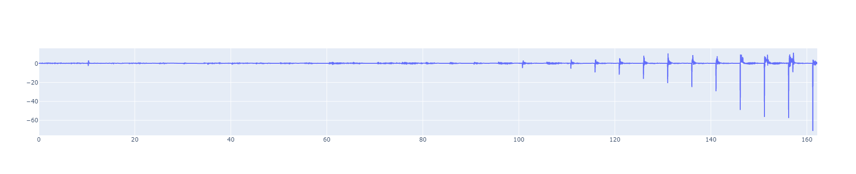
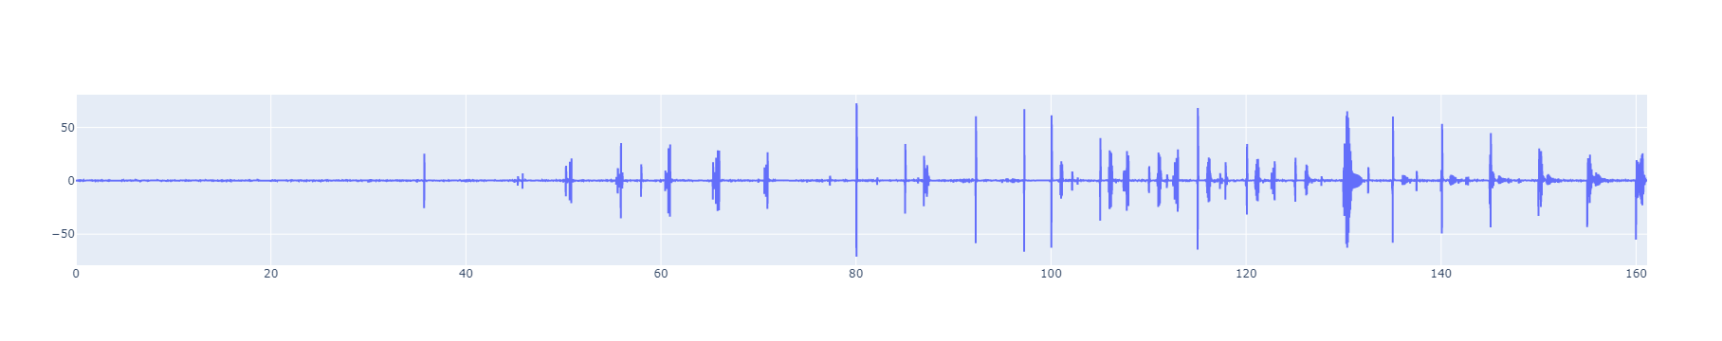
TD-Error on 0.04 network (trained on 8G)

Slide 15
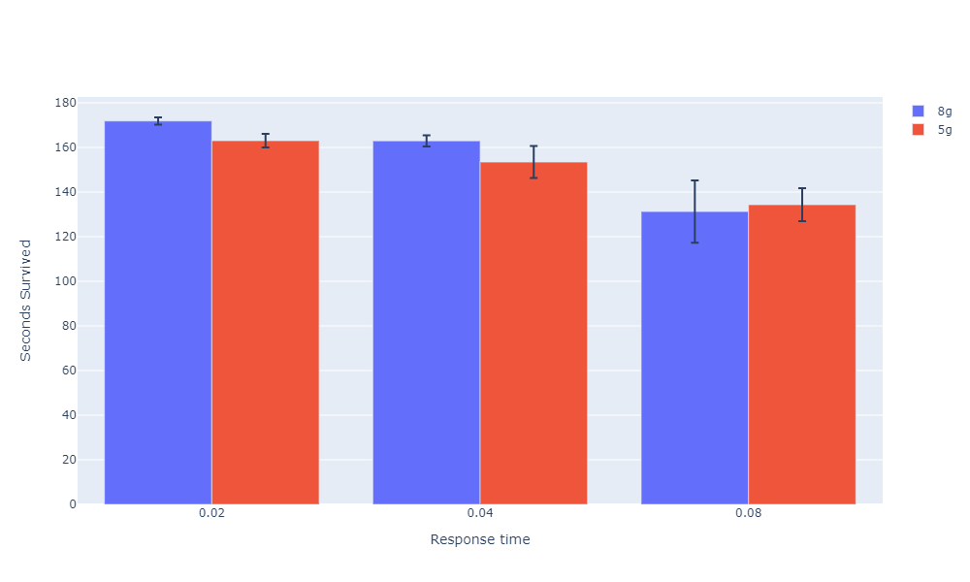
Averaged over 10 seeds and 10 episodes

Slide 16
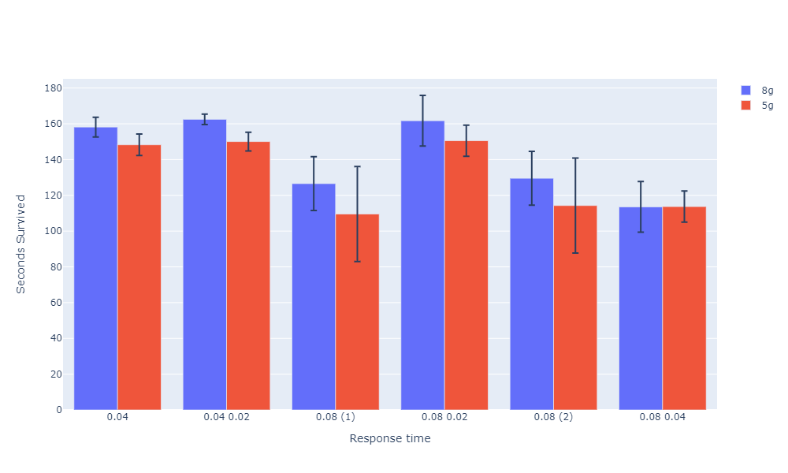
Averaged over 10 seeds and 10 episodes
Faster network trained normally over slower network

Slide 17
To check
Check few shot learning with reflexes
Transfer reflexes
Reflexes prevent negative rewards.
Add parent action and child action in state representation.
Slowly add reflexes on a trained network (while training it again).
Make parent network’s actions come in faster at dying states or states that have a drastic change in reward.

Slide 18
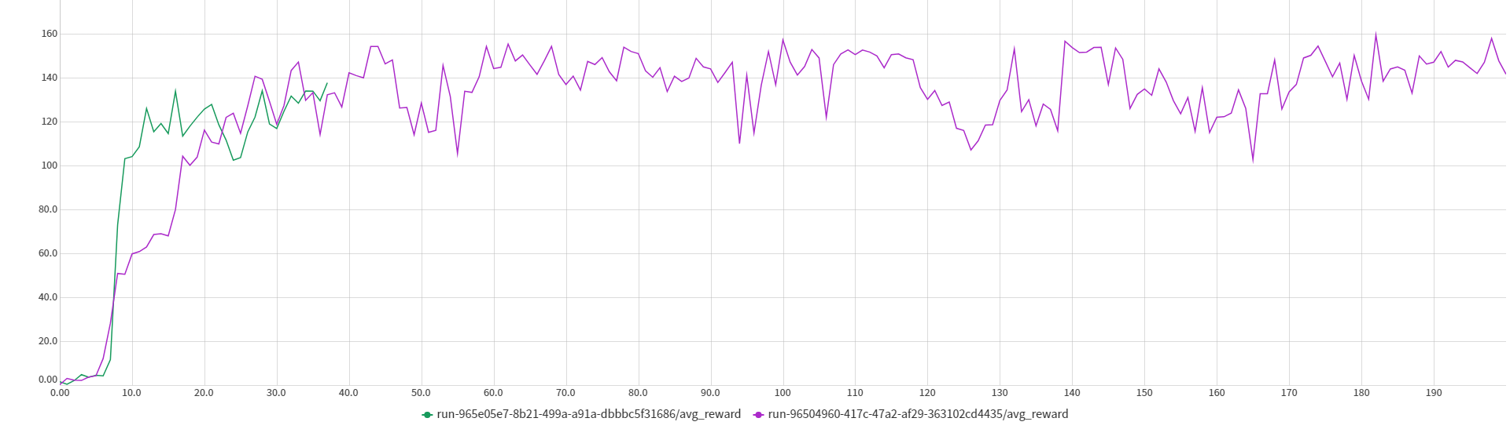
Approach on edge cases
Train a neural network on states that result on failure on the Teacher network.
Pick the same action but faster.
Neural network: 6 hidden neurons

Slide 19
Other summer works
DITTO
Submit to AAAI
Work on thesis proposal (due next sem)

Slide 20
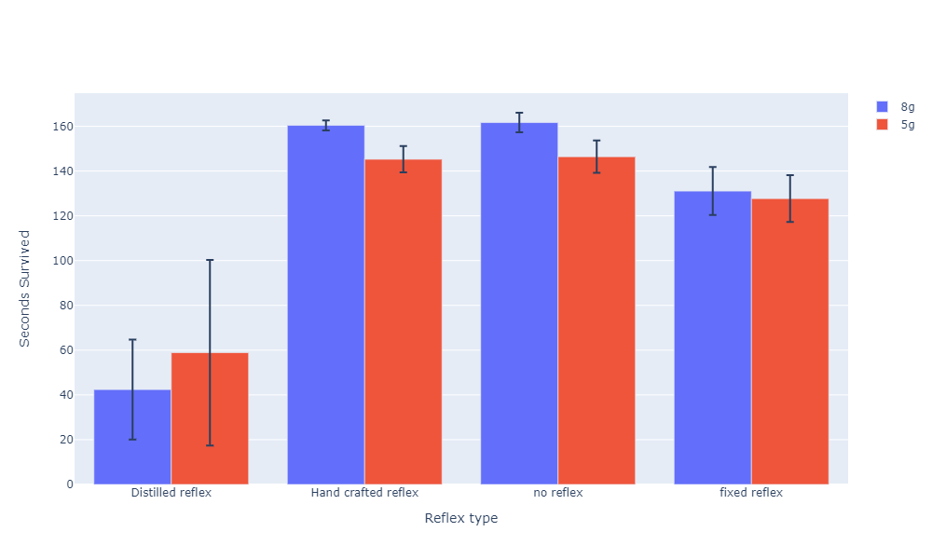
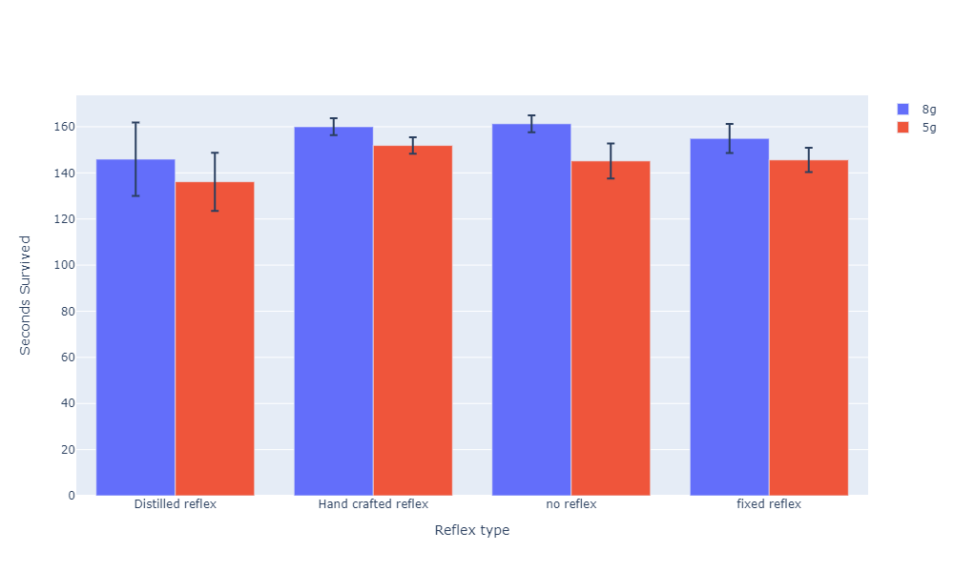
Reflex added after training
Reflex added before training

Slide 21
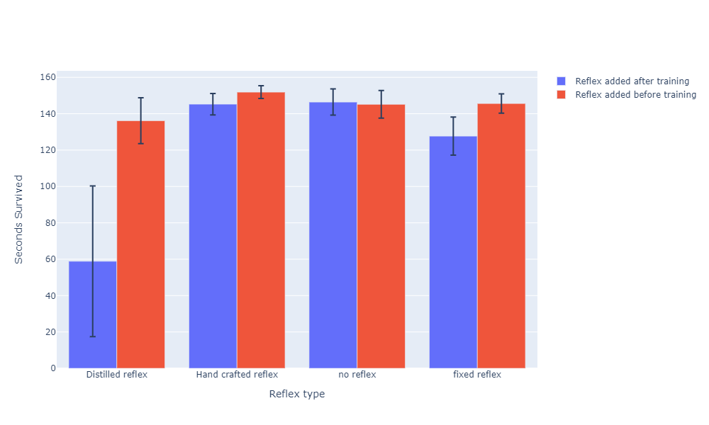
Averaged over 10 seeds and 10 episodes
5g pertubation

Slide 22
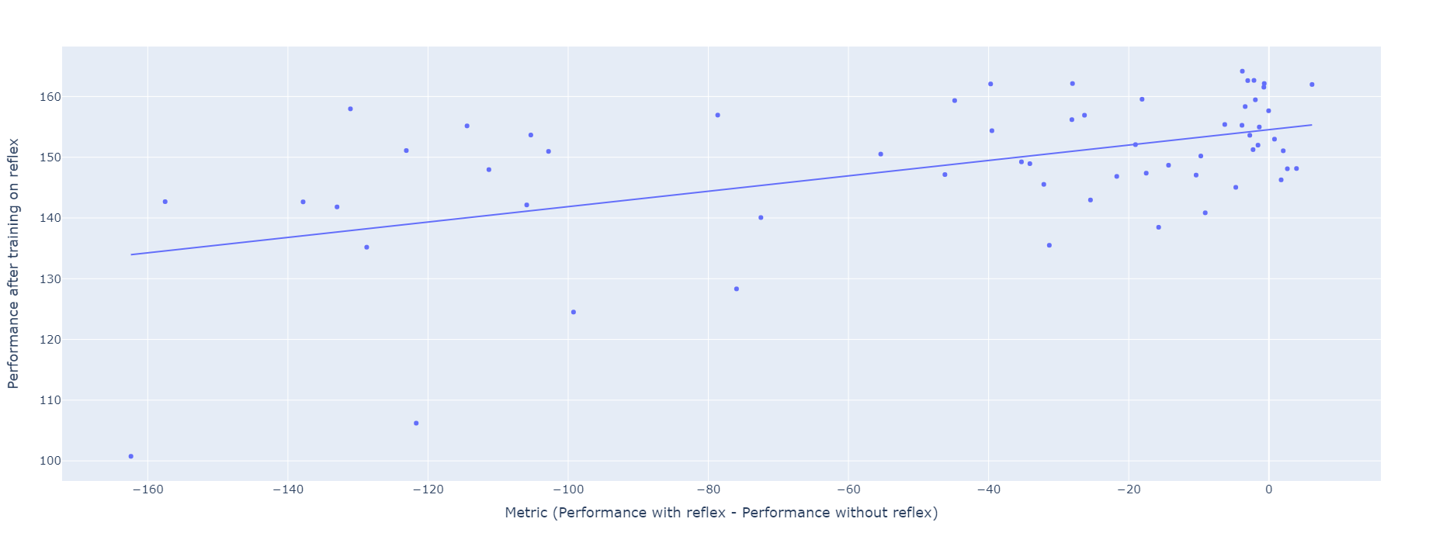
Perturbation: 5g
Reflex types: distillation, hand crafted, distillation (low error)
Seeds: 10
Each dot is avg. over 10 episodes

Slide 23
Reward = 0.12 * metric + 154.53
Not very strong correlation. Might be better if seeds are also averaged.

Slide 24
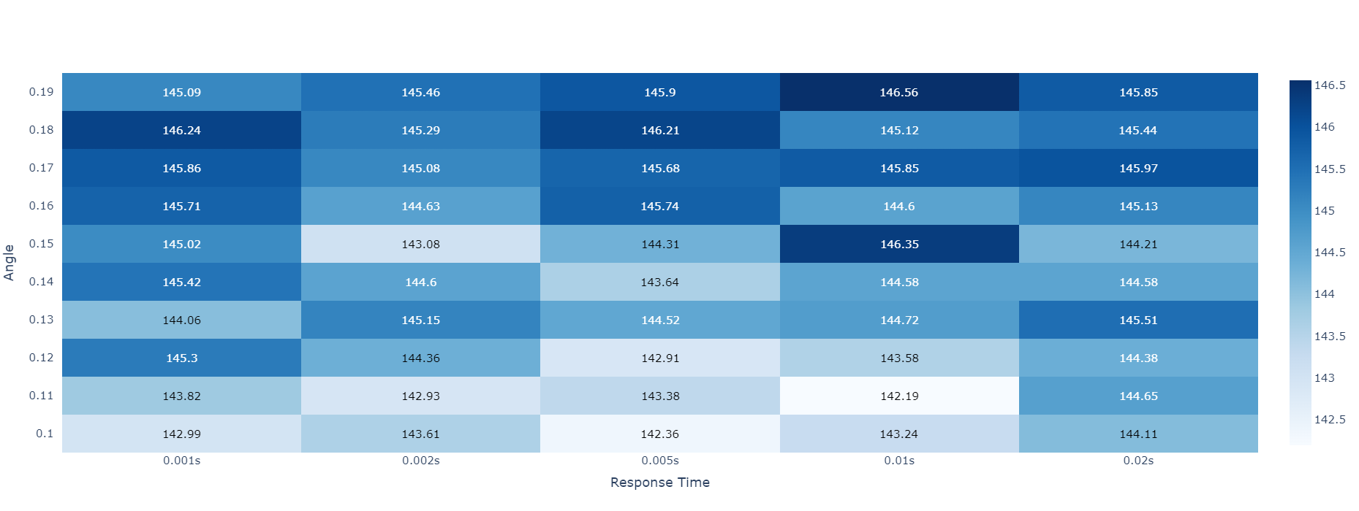
Manually searching for reflex using the metric
Not promising. The performance does not vary a lot.
Should try for 80ms response times.

Slide 25
Reflex search using Cross-entropy
The reflex is parametrized as:
For each action dimension:
Θ₁: A threshold value for each input dimension
Θ₂: A scaling value that controls the intensity of the reflex action
Note that two neurons are required for a low and high threshold. However, the parameters can be reduced if the reflex is symmetric
Θ₁
Θ₂
Reflex parametrization

Slide 26
Same robustness performance with 70% of the actions picked.

Slide 27
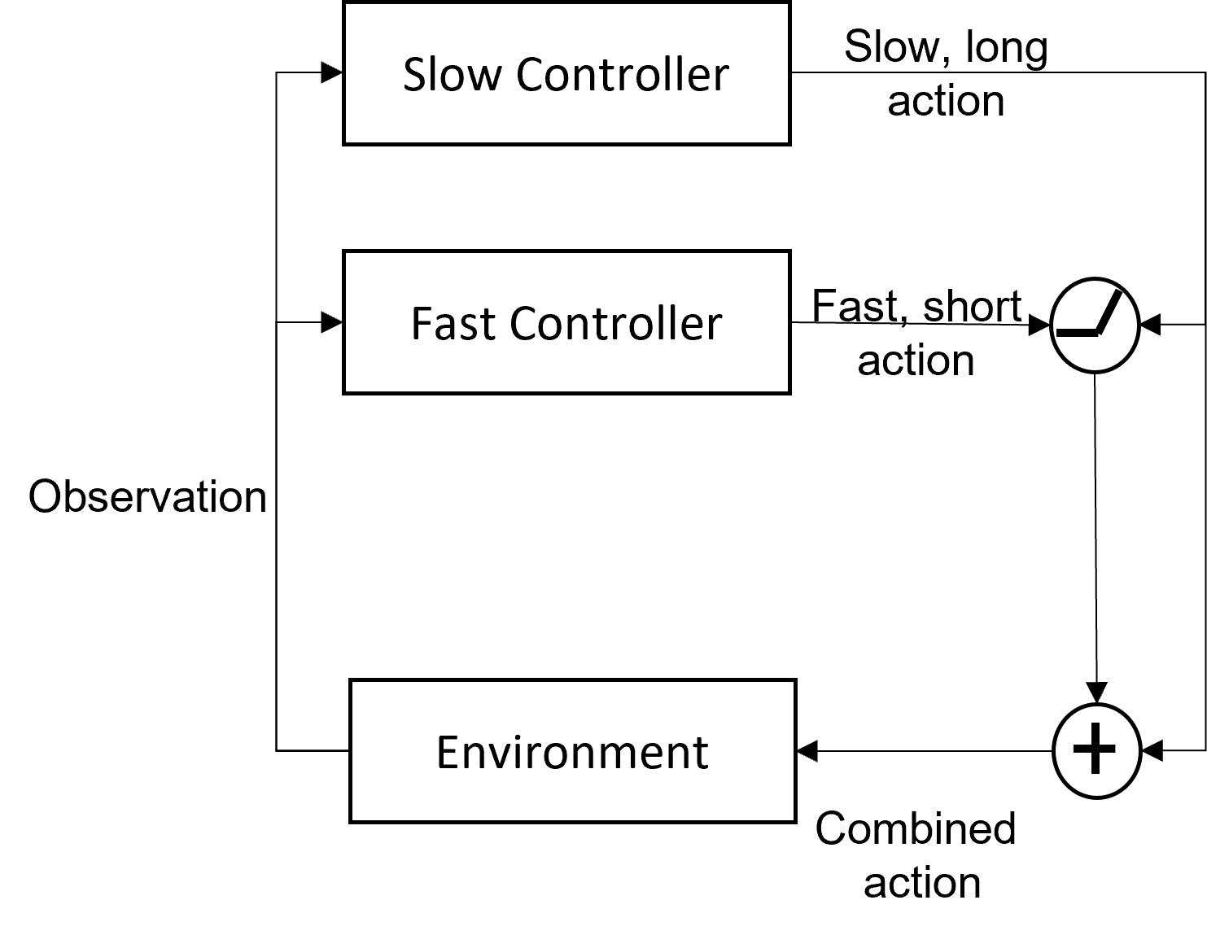
Slow Controller
Slow, Long Action
Fast Controller
Short, Fast
Action
Gate
Observation
Environment
Combined
Action

Slide 28
Separate Systems
Environment | TLA |  | TLA (oblivious slow network)
 | Return | RPA | Return | RPA
InvertedPendulum-v2 | 1000.00±0.0 | 1.96 | 1000.00±0.0 | 1.99
InvertedDoublePendulum-v2 | 9178.39±404.38 | 18.58 | 9170.52±407.33 | 10.74
Hopper-v2 | 3443.21±131.61 | 3.74 | 3448.76±84.18 | 3.93
Walker2d-v2 | 3694.04±128.58 | 3.96 | 2972.13±793.65 | 3.48

Slide 29
With Slow Action
Initial Fast action
F
F
F
F
Environment
S
S
Initial Slow action
TIME

Slide 30
With Oblivious Slow Network
Initial Fast action
F
F
F
F
Environment
S
S
Initial Slow action
TIME

Slide 31
Without Slow Action
Initial Fast action
F
F
F
F
Environment
S
S
Initial Slow action
TIME

Slide 32
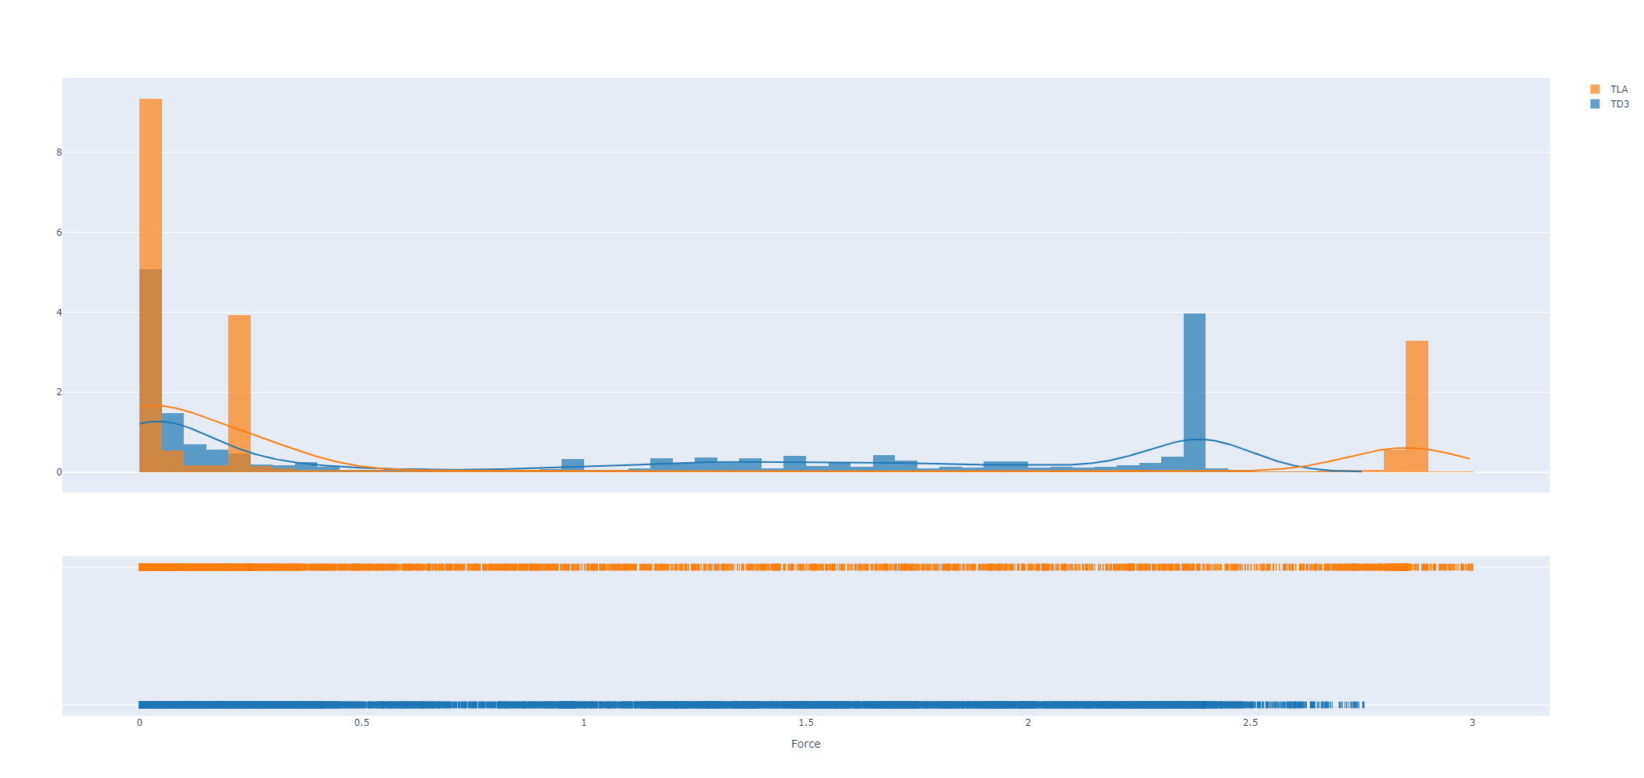
Efficiency – InvertedPendulum-v2

Slide 33
Efficiency - force
Environment | Avg. Force TD3 | Avg. Force TLA
InvertedPendulum-v2 | 1.06 ± 0.99 | 0.74 ± 1.13
InvertedDoublePendulum-v2 | 0.004 ± 0.046 | 0.030 ± 0.048
Hopper-v2 | 0.56 ± 0.37 | 0.73 ± 0.33
Walker2d-v2 | 0.83 ± 0.27 | 0.88 ± 0.24

Slide 34
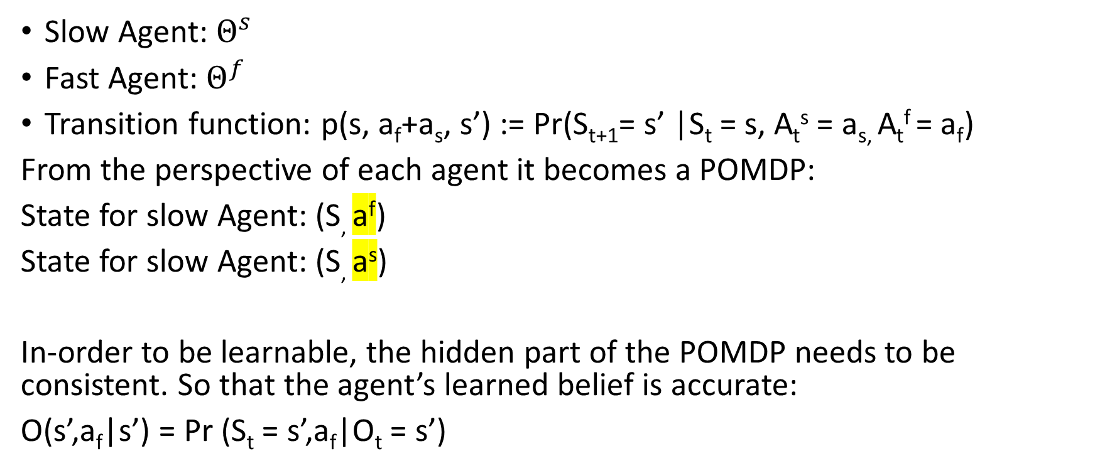
Temporally layered architecture as a Multi-agent system
Slow Agent: $Θ^{s}$
Fast Agent: $Θ^{f}$
Transition function: p(s, a_{f}+a_{s}, s’) := Pr(S_{t+1}= s’ |S_{t} = s, A_{t}^{s} = a_{s,} A_{t}^{f} = a_{f})
From the perspective of each agent it becomes a POMDP:
State for slow Agent: (S, a^{f})
State for slow Agent: (S, a^{s})
In-order to be learnable, the hidden part of the POMDP needs to be consistent. So that the agent’s learned belief is accurate:
O(s’,a_{f}|s’) = Pr (S_{t} = s’,a_{f}|O_{t} = s’)
Hidden

Slide 35
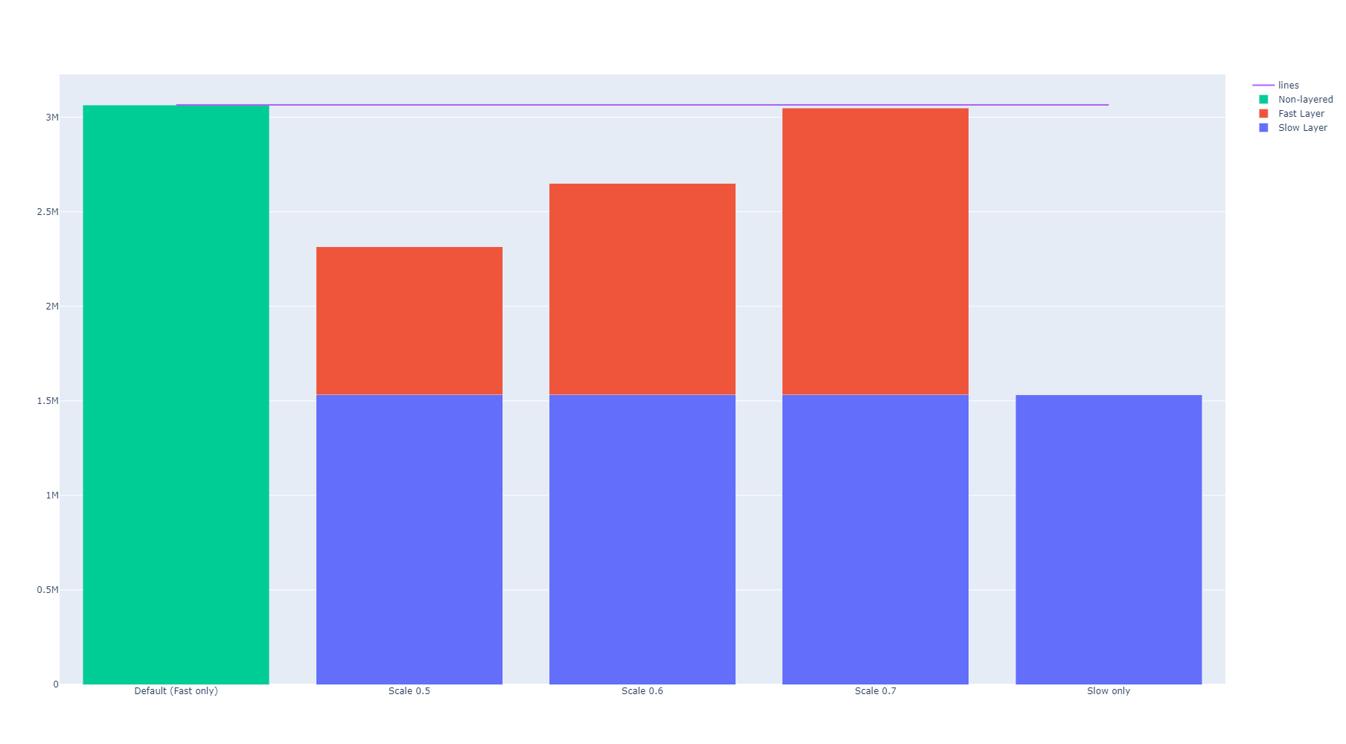
Scaling down the fast network makes the TLA compute efficient

Slide 36
Adaptive response time for efficiency
Gate the fast controller using the slow controller.
Thus, The fast controller is only invoked if required by the slow controller.
Slow Controller
Slow, Long Action
Fast Controller
Short, Fast
Action
Observation
Environment
Combined
Action

Slide 37
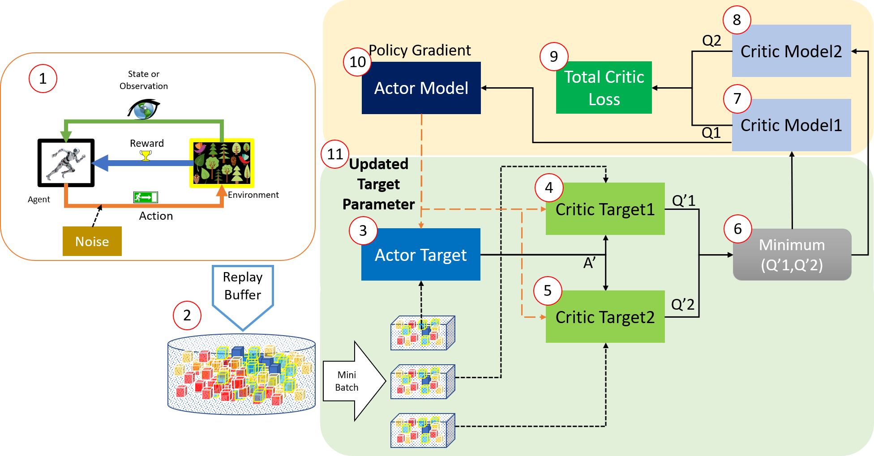
How? TD3: Twin-Delayed Deep Delayed Poilcy Gradient (TD3)

Slide 38
Actor and critic act as a single neural network
The action needs to be continuous for the actor to be trained.
Environment
Actor
Critic
action
Value
Loss = -Value

Slide 39
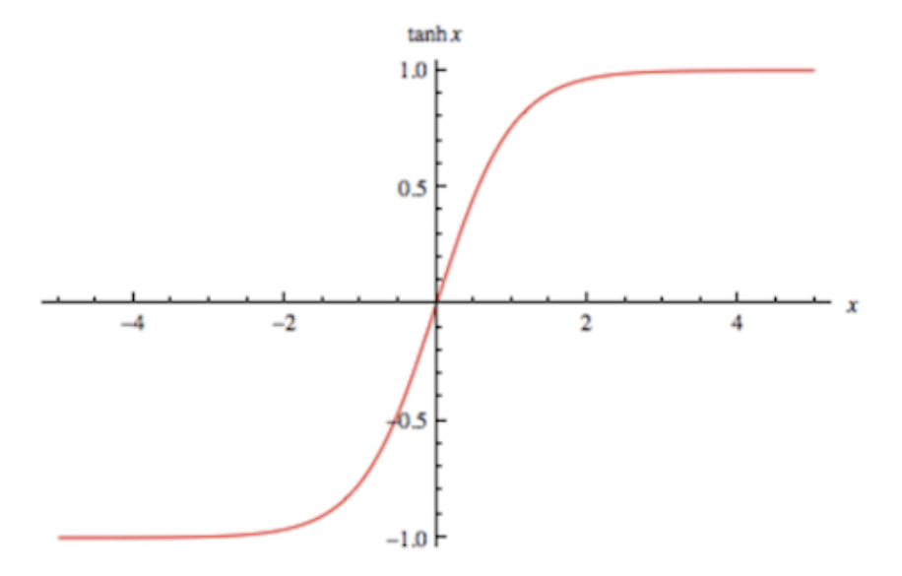
Approach 1:
Gate output:
Slow Controller
Slow, Long Action
Algorithm:
Train Fast Controller
Train Slow control with dual outputs: Action and gate
If Gate > 0:
Action = Slow action if gate > 0
Else
Action = Fast action
Reward = reward / 2 if gate < 0
Gate output
Fast Controller
Short, Fast Action
gate
Observation
Action
Environment
Incentivizes slow actions

Slide 40
Approach 1: Results
Slow Controller
Slow, Long Action
Slow Response Rate | Fast Response Rate | Avg. Slow Actions | Avg. Fast Actions | Avg. Reward
- | 0.04 | - | 1000.00 | 1000.00
0.08 | 0.04 | 500.00 | 0.00 | 1000.00
0.12 | 0.04 | 334.00 | 106.66 | 1000.00
0.16 | 0.04 | 241.74 | 154.66 | 966.90
0.20 | 0.04 | 167.28 | 206.12 | 835.90
0.24 | 0.04 | 163.86 | 593.16 | 981.24
0.28 | 0.04 | 102.86 | 512.80 | 718.00
0.32 | 0.04 | 106.94 | 719.36 | 854.32
0.36 | 0.04 | 79.50 | 652.76 | 709.18
0.40 | 0.04 | 97.80 | 865.20 | 977.92
Gate output
Fast Controller
Short, Fast Action
gate
Observation
Action
Environment

Slide 41
Approach 1: Results
Slow Controller
Slow, Long Action
Gate output
Slow controller dominant
Fast controller dominant
Fast Controller
Short, Fast Action
energy sweet spot
gate
Observation
Action
Environment

Slide 42
Approach 1: Issues
Approach one fails to find an optimal policy for slower response rates
Possibly because the fast policy is not generalized. i.e., it sees states that it was not trained on.
Slow Response Rate | Fast Response Rate | Avg. Slow Actions | Avg. Fast Actions | Avg. Reward
- | 0.04 | - | 1000.00 | 1000.00
0.08 | 0.04 | 500.00 | 0.00 | 1000.00
0.12 | 0.04 | 334.00 | 106.66 | 1000.00
0.16 | 0.04 | 241.74 | 154.66 | 966.90
0.20 | 0.04 | 167.28 | 206.12 | 835.90
0.24 | 0.04 | 163.86 | 593.16 | 981.24
0.28 | 0.04 | 102.86 | 512.80 | 718.00
0.32 | 0.04 | 106.94 | 719.36 | 854.32
0.36 | 0.04 | 79.50 | 652.76 | 709.18
0.40 | 0.04 | 97.80 | 865.20 | 977.92

Slide 43
Approach 1a
Slow Controller
Slow, Long Action
Slow Response Rate | Fast Response Rate | Avg. Slow Actions | Avg. Fast Actions | Avg. Reward
0.08 | 0.04 | 500.00 | 874.32 | 1000.00
0.12 | 0.04 | 315.26 | 738.74 | 943.80
0.16 | 0.04 | 250.00 | 897.76 | 1000.00
0.20 | 0.04 | 196.62 | 939.10 | 983.10
0.24 | 0.04 | 163.74 | 972.84 | 980.48
0.28 | 0.04 | 140.60 | 968.80 | 983.22
0.32 | 0.04 | 121.24 | 956.80 | 969.84
0.36 | 0.04 | 101.82 | 879.14 | 909.04
0.40 | 0.04 | 96.58 | 956.94 | 965.64
Gate output
Fast Controller
Short, Fast Action
gate
Observation
Action
Environment
Way too many fast actions
Zero out the slow action when fast action is chosen. Thus, ensuring weight updates to only the gate.

Slide 44
Approach 2:
Slow Controller
Slow, Long Action
Gate
Inspired by differentiable gates and masking, we make the gate continuous.
Fast controller is trained first.
Slow controller is trained after with the gate.
Fast Controller
1-Gate
Observation
Action
Environment

Slide 45
Approach 2: Results
Threshold = 1 (always fast)
Threshold = 0.9
Slow Response Rate | Fast Response Rate | Avg. Slow actions | Avg. Fast Actions | Avg. Reward
0.08 | 0.04 | 500.00 | 1000.00 | 1000.00
0.12 | 0.04 | 333.08 | 997.26 | 997.26
0.16 | 0.04 | 250.00 | 1000.00 | 1000.00
0.20 | 0.04 | 200.00 | 1000.00 | 1000.00
0.24 | 0.04 | 152.52 | 913.14 | 913.14
0.28 | 0.04 | 143.00 | 1000.00 | 1000.00
0.32 | 0.04 | 121.38 | 970.96 | 970.96
0.36 | 0.04 | 83.70 | 746.76 | 746.76
0.40 | 0.04 | 83.98 | 838.84 | 838.84
Slow Response Rate | Fast Response Rate | Avg. Slow actions | Avg. Fast Actions | Avg. Reward
0.08 | 0.04 | 500.00 | 3.88 | 1000.00
0.12 | 0.04 | 320.50 | 0.24 | 959.50
0.16 | 0.04 | 250.00 | 2.40 | 1000.00
0.20 | 0.04 | 200.00 | 389.90 | 1000.00
0.24 | 0.04 | 62.18 | 319.72 | 370.70
0.28 | 0.04 | 105.82 | 728.06 | 739.36
0.32 | 0.04 | 120.50 | 878.10 | 963.76
0.36 | 0.04 | 59.26 | 512.72 | 528.76
0.40 | 0.04 | 83.98 | 838.84 | 838.84
Threshold = 0.95
Threshold = 0.99
Slow Response Rate | Fast Response Rate | Avg. Slow actions | Avg. Fast Actions | Avg. Reward
0.08 | 0.04 | 500.00 | 5.96 | 1000.00
0.12 | 0.04 | 334.00 | 9.60 | 1000.00
0.16 | 0.04 | 250.00 | 2.40 | 1000.00
0.20 | 0.04 | 200.00 | 392.20 | 1000.00
0.24 | 0.04 | 97.82 | 528.84 | 585.12
0.28 | 0.04 | 128.82 | 881.50 | 900.40
0.32 | 0.04 | 122.90 | 887.70 | 983.06
0.36 | 0.04 | 82.90 | 726.34 | 739.74
0.40 | 0.04 | 83.98 | 838.84 | 838.84
Slow Response Rate | Fast Response Rate | Avg. Slow actions | Avg. Fast Actions | Avg. Reward
0.08 | 0.04 | 500.00 | 8.16 | 1000.00
0.12 | 0.04 | 323.32 | 30.56 | 967.98
0.16 | 0.04 | 250.00 | 4.32 | 1000.00
0.20 | 0.04 | 200.00 | 403.80 | 1000.00
0.24 | 0.04 | 150.06 | 873.70 | 898.42
0.28 | 0.04 | 143.00 | 999.72 | 1000.00
0.32 | 0.04 | 120.50 | 879.88 | 963.72
0.36 | 0.04 | 83.70 | 743.50 | 746.92
0.40 | 0.04 | 83.98 | 838.84 | 838.84

Slide 46
Approach 2:
Slow Controller
Slow, Long Action
Gate
Fast Controller
energy sweet spot
1-Gate
Observation
Action
Environment

Slide 47
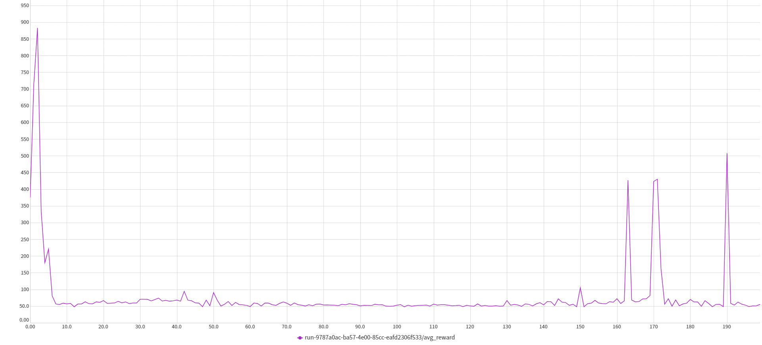
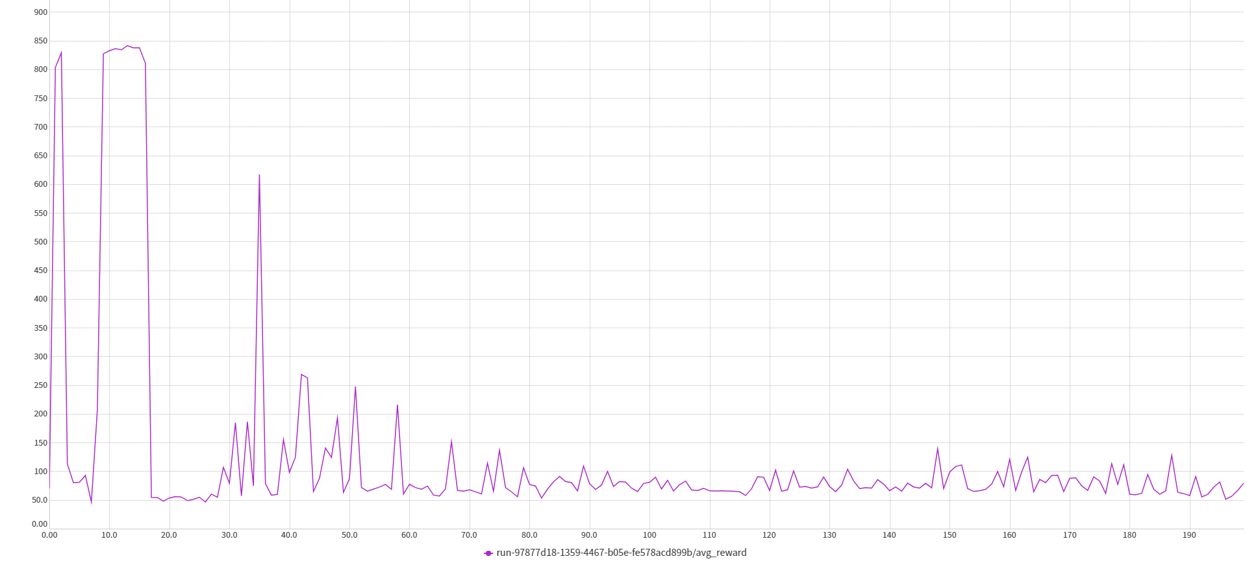
Approach 2: Issues
Learning is unstable and diverges after first few updates

Slide 48


Benefits of adaptive action frequency:
Faster learning through better exploration
Compute Efficiency
Action Efficiency (Jerk)
Temporal abstraction
Explainability
Methods | Better Exploration | Efficiency (Energy) | Temporal Abstraction | XAI | Continuous Environments | Action space explosion
Ours
Ours (Proposed)
CTC | ~ | ~
TempoRL
FiGAR
TAAC
~
~
~
~

